Slide 1
Apache Storm
Distributed and fault-tolerant real-time Processing System

Slide 2
Team Members
Gary Mendonca (43)
Linson Miranda (44)
Preetham Monis (45)

Slide 3
Contents
What is Storm?
Storm vs Hadoop
Core Concepts
Cluster Architecture
a. Components
b. Apache ZooKeeper
Working
Benefits
Demo

Slide 4

What is Storm?
Apache Storm is a distributed real-time big data-processing system.
Storm: The Hadoop of real-time processing.
Storm is designed to process vast amount of data in a fault-tolerant and horizontal scalable method.
Storm is written primarily in Clojure and is designed to support wiring “spouts” and “bolts” together as a directed acyclic graph(DAG) called a topology.

Slide 5
Storm Vs Hadoop
Feature | Storm | Hadoop
Processing Methods | Real-time stream | Batch
Protocol | Stateless | Stateful
Processing speeds | A Storm streaming process can access tens of thousands messages per second on cluster | Hadoop Distributed File System (HDFS) uses MapReduce framework to process vast amount of data that takes minutes or hours.
Execution order | Runs until shutdown by the user or an unexpected unrecoverable failure. | MapReduce jobs are executed in a sequential order and completed eventually

Slide 6
Feature | Storm | Hadoop
Master/Slave Configuration | Master/Slave architecture with ZooKeeper based coordination. The master node is called as nimbus and slaves are supervisors. | Master-slave architecture with/without ZooKeeper based coordination. Master node is job tracker and slave node is task tracker.
Distribution & Fault-tolerance | Yes | Yes
Recoverability | If nimbus / supervisor dies, restarting makes it continue from where it stopped, hence nothing gets affected. | If the JobTracker dies, all the running jobs are lost

Slide 7
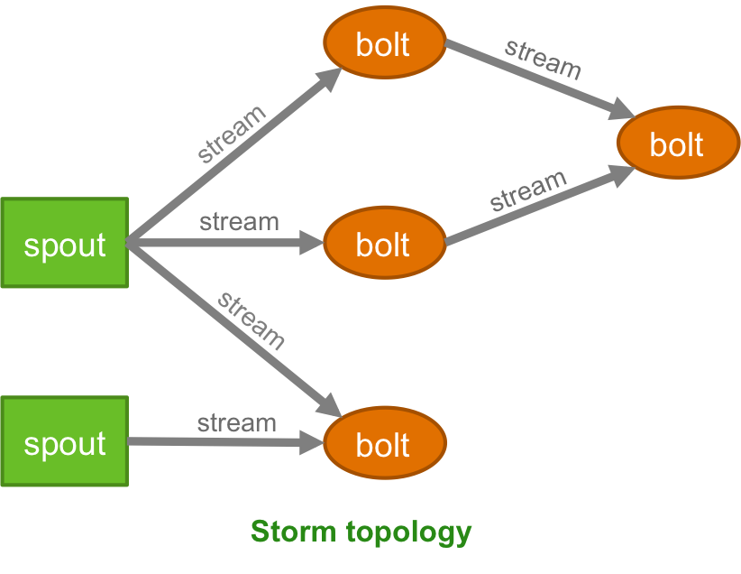
Core Concepts
Apache Storm reads raw stream of real-time data from one end and passes it through a sequence of small processing units and output the processed / useful information at the other end.

Slide 8
Tuple – Immutable set of key/value pairs. Tuple is the main data structure in Storm. It is a list of ordered elements. By default, a Tuple supports all data types. Generally, it is modelled as a set of comma separated values and passed to a Storm cluster.
Stream – An unbounded,unordered sequence of tuples that can be processed in parallel by Storm.
Topology – A directed graph where vertices are computation and edges are stream of data. A simple topology starts with spouts.
Spout – Source of data streams(tuples). Can be run in reliable and unreliable modes.
Bolt – Consumes 1+ streams to produce new streams. Complex operations often require multiple steps, & thus multiple bolts.

Slide 9
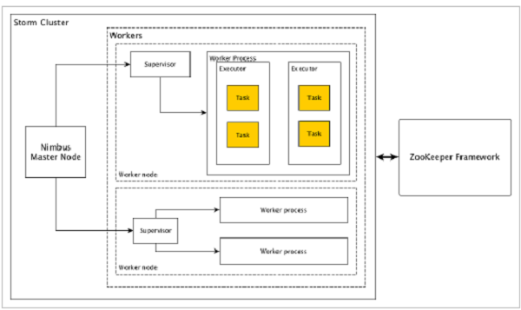
Cluster Architecture
Apache Storm has two type of nodes, Nimbus (master node) and Supervisor (worker node).

Slide 10
Cluster Architecture Components
Component | Description
Nimbus | Nimbus is a master node of Storm cluster. It is responsible for distributing data among all the worker nodes, assign tasks to worker nodes and monitoring failures
Supervisor | The nodes that follow instructions given by the nimbus are called as Supervisors. A supervisor has multiple worker processes and it governs worker processes to complete the tasks assigned by the nimbus
Worker Process | A worker process will execute tasks related to a specific topology. A worker process will not run a task by itself, instead it creates executors and asks them to perform a particular task. A worker process will have multiple executors.
Executor | An executor is nothing but a single thread spawn by a worker process. An executor runs one or more tasks but only for a specific spout or bolt.
Task | A task performs actual data processing. So, it is either a spout or a bolt.

Slide 11
Apache ZooKeeper
ZooKeeper is a distributed co-ordination service to manage large set of hosts.
Apache ZooKeeper is a service used by a cluster (group of nodes) to coordinate between themselves and maintaining shared data with robust synchronization techniques. Nimbus is stateless, so it depends on ZooKeeper to monitor the working node status.
ZooKeeper helps the supervisor to interact with the nimbus. It is responsible to maintain the state of nimbus and supervisor.

Slide 12
Benefits of using ZooKeeper
Simple distributed coordination process
Synchronization − Mutual exclusion and co-operation between server processes. This process helps in Apache HBase for configuration management.
Ordered Messages
Serialization − Encode the data according to specific rules. Ensure your application runs consistently. This approach can be used in MapReduce to coordinate queue to execute running threads.
Reliability
Atomicity − Data transfer either succeed or fail completely, but no transaction is partial.

Slide 13
Working
The following is the workflow of the cluster model:
Initially, the nimbus will wait for the “Storm Topology” to be submitted to it.
Once a topology is submitted, it will process the topology and gather all the tasks that are to be carried out and the order in which the task is to be executed.
Then, the nimbus will evenly distribute the tasks to all the available supervisors.
At a particular time interval, all supervisors will send heartbeats to the nimbus to inform that they are still alive.
When a supervisor dies and doesn’t send a heartbeat to the nimbus, then the nimbus assigns the tasks to another supervisor.

Slide 14
When the nimbus itself dies, supervisors will work on the already assigned task without any issue.
Once all the tasks are completed, the supervisor will wait for a new task to come in.
In the meantime, the dead nimbus will be restarted automatically by service monitoring tools.
The restarted nimbus will continue from where it stopped. Similarly, the dead supervisor can also be restarted automatically. Since both the nimbus and the supervisor can be restarted automatically and both will continue as before, Storm is guaranteed to process all the task at least once.
Once all the topologies are processed, the nimbus waits for a new topology to arrive and similarly the supervisor waits for new tasks.

Slide 15
Benefits of Storm
Storm is open source, robust, user friendly & allows real-time stream processing.
It is fault tolerant, flexible, reliable, and supports any programming language.
It is unbelievably fast because it has enormous power of processing the data.
It can keep up the performance even under increasing load by adding resources linearly. It is highly scalable.
It provides guaranteed data processing even if any of the connected nodes in the cluster die or messages are lost.
It excels at event processing and incremental computation.

Slide 16
Demonstration of Storm Using Twitter API’s

Slide 17
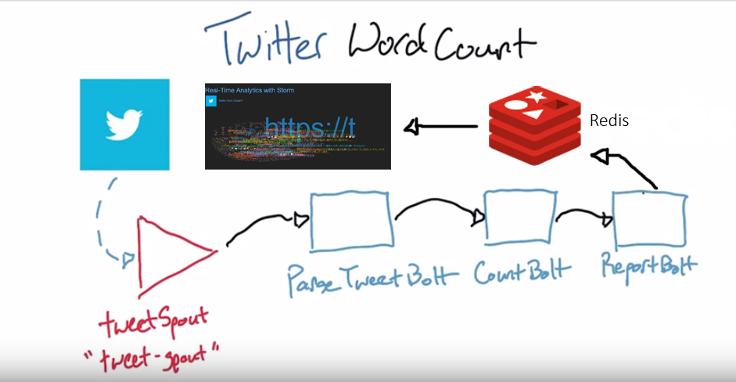

Slide 18
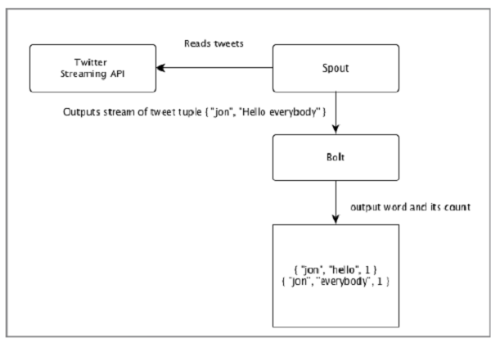
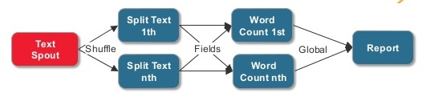

Slide 19
Thank you

